Slide 1
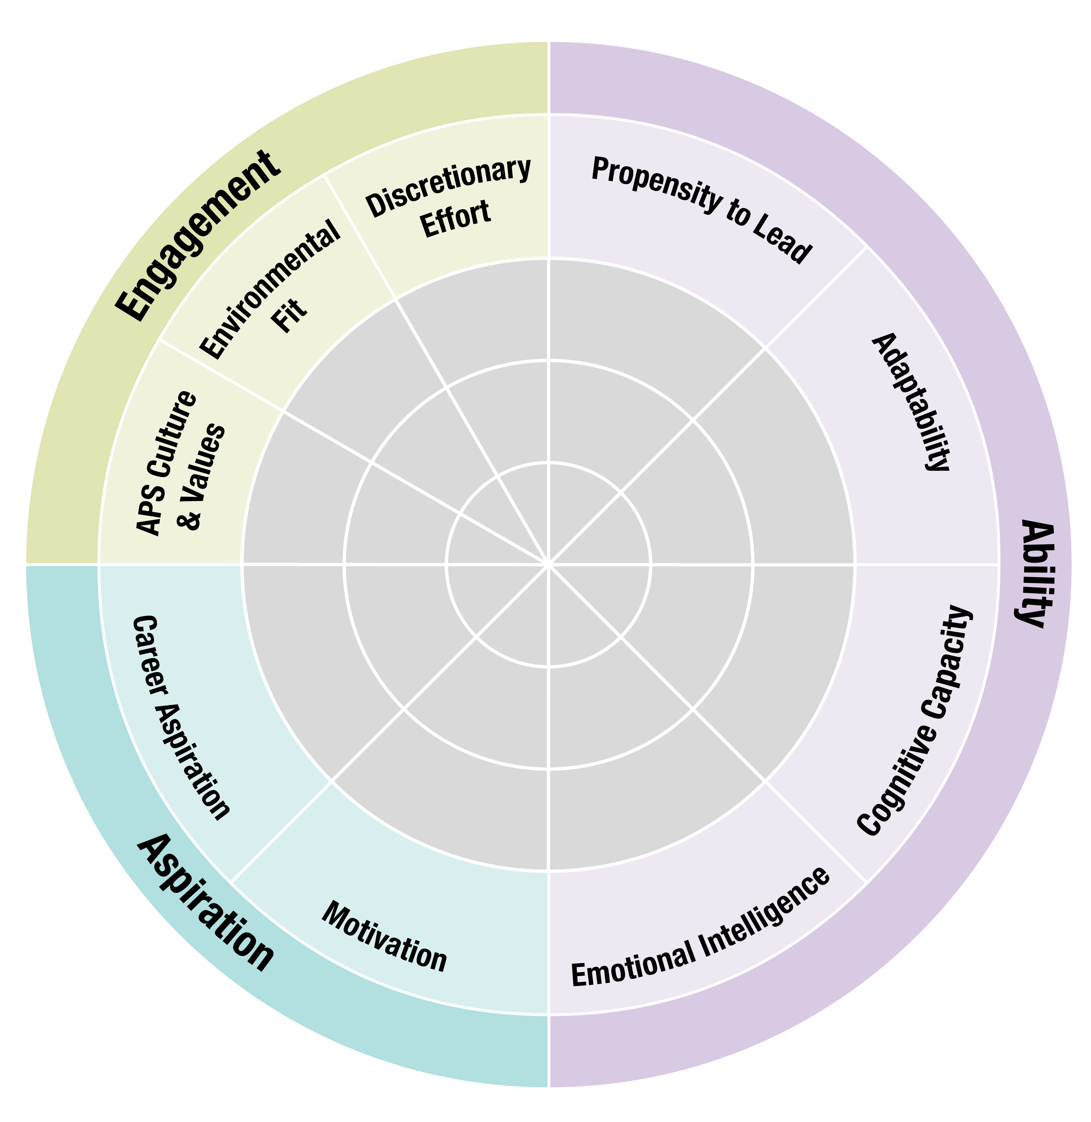
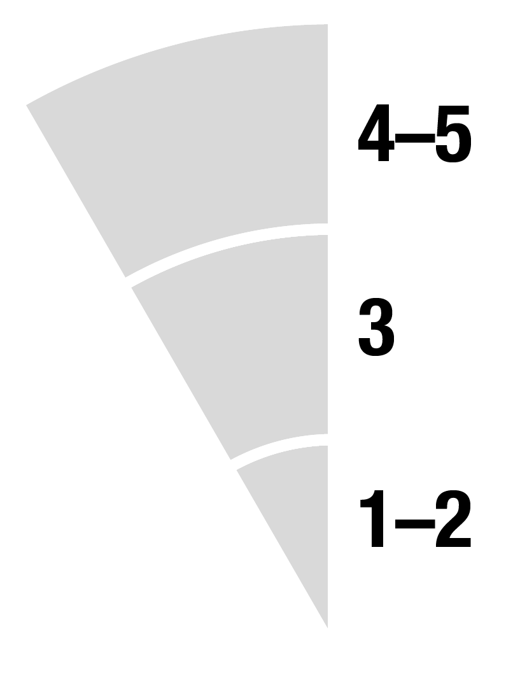
Editable visual indicator
Outer ring 4–5 (High Potential)
Middle ring: 3 (Moderate Potential)
Inner ring: 1–2 (Potential)

