Slide 1
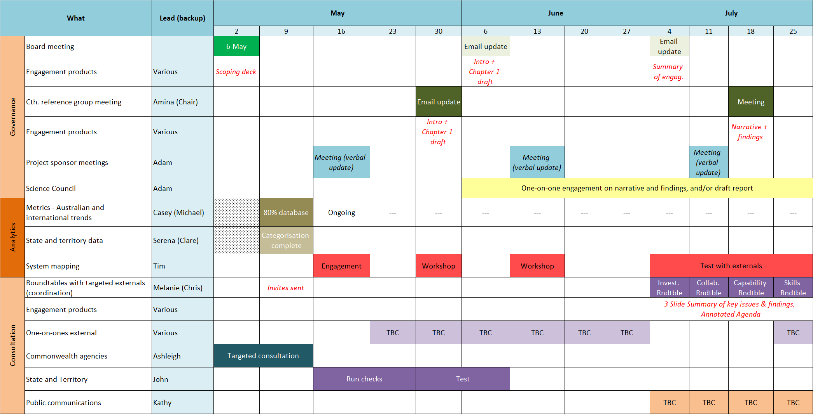
Example 1 – Workplan created in Microsoft Excel
Below is a screenshot of an example workplan created in Microsoft Excel. Excel provides an adaptable format that works well for planning longer duration taskforce projects.

Slide 2
Example 2 – Workplan created in PowerPoint
An example workplan, created in Microsoft PowerPoint. PowerPoint provides a more tidy and concise format that works well for planning shorter duration taskforce projects, or to present a snapshot from a longer duration workplan.
Research and consultations commence
Secretaries receive final report, roadmap & public engagement strategy
Key milestones
 | June |  |  |  |  | July |  |  |  | August
Item | 1 June | 8 June | 15 June | 22 June | 29 June | 6 July | 13 July | 20 July | 27 July | 3 August | 10 August | 17 August | 24 August | 31 August
Governance | Steering Group (FAS, Finance, ABS, DISER) |  |  | FAS convenes Dep Sec Working Group |  | Steering Group (FAS, Finance, ABS, DISER) |  | Secretaries Meeting | FAS convenes Dep Sec Working Group | Steering Group (FAS, Finance, ABS, DISER) |  |  | Steering Group (FAS, Finance, ABS, DISER)
Research and consultation |  | Targeted meetings with key Cth agencies |  | Consults – data users (academics, private sector) to identify priority sets |  | Consults – best practice UK, Canada, NZ and Australia |  | Consults – technical workshop and design features
Policy/report development |  |  |  |  |  |  | Report – draft outline of report and road map | Secretaries – outline of final report and road map | Report/ chapter – barriers (legislation/ privacy/ technical issues) | Report/ chapter – data analytics capability | Draft report & road map with recs + public engmt strategy paper
Government agreement |  |  |  |  |  |  |  |  |  |  |  |  | Report finalised and agreed by IDC (out of session) | Secretaries receive final report. road map and strategy

