Slide 1
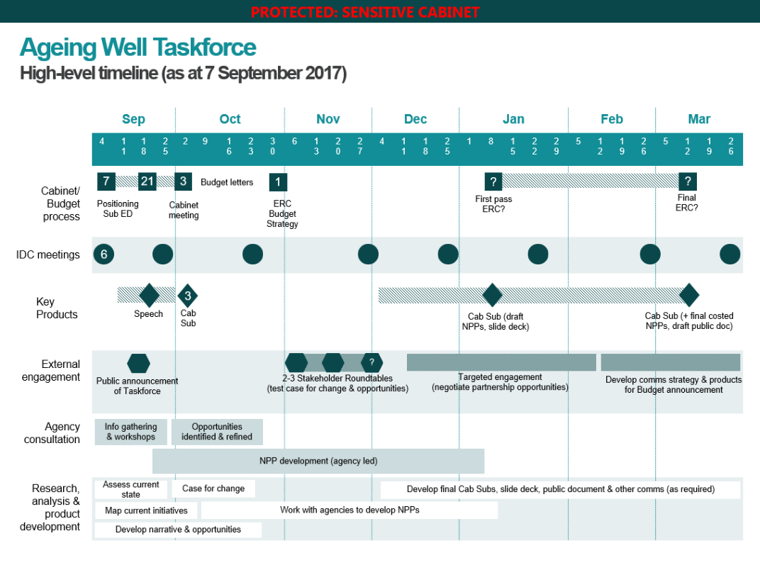
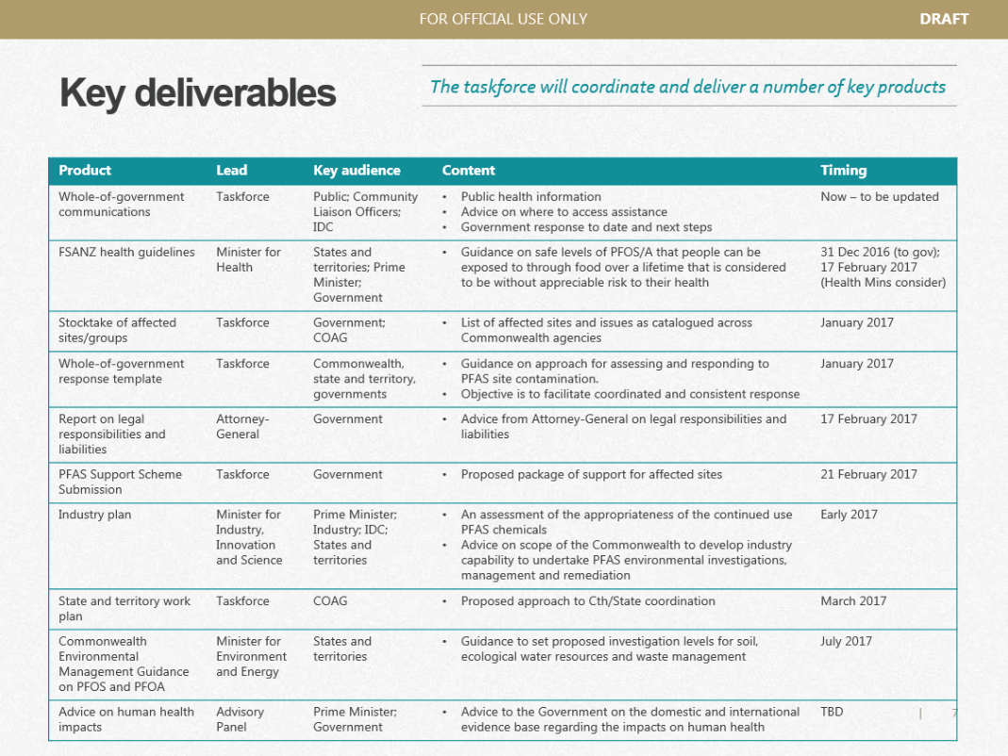
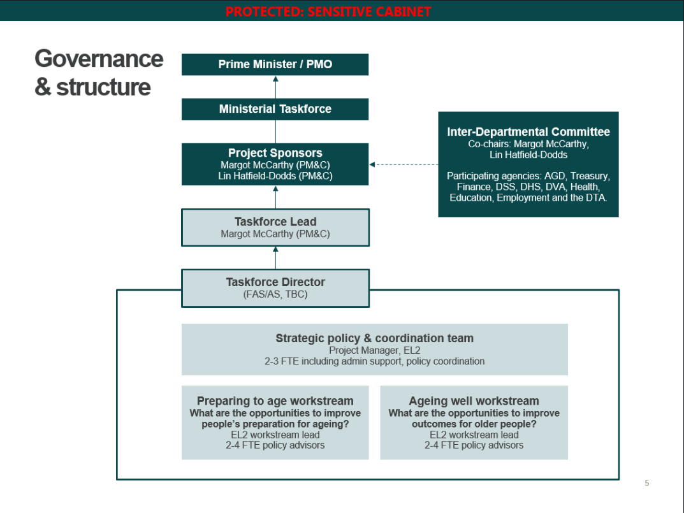
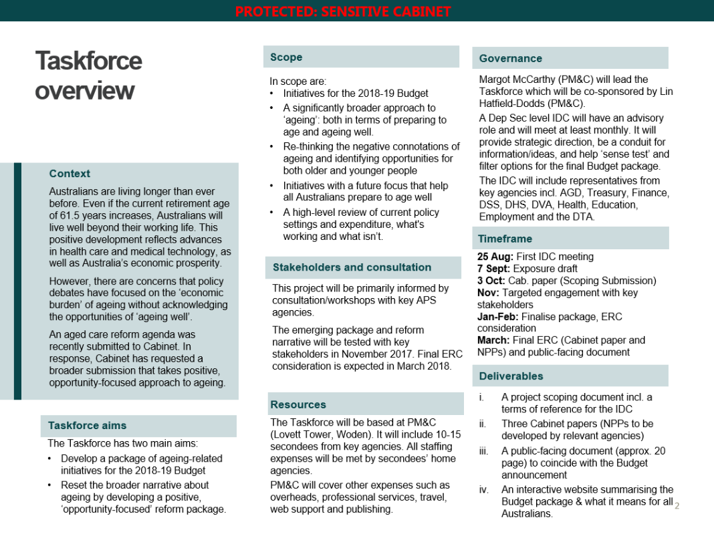
How to use this resource
Attached is a scoping deck template that you can adapt to your taskforce.
A scoping deck is an effective tool for articulating the scope of the taskforce ahead of a terms of reference being drafted and work commencing.
It can be used to get decision makers and key stakeholders on the same page ahead of formal sign-off through the terms of reference.
The scoping deck will also shape and capture early thinking on:
defining the problem the taskforce will be addressing
governance
staffing and resource needs
deliverables
a high-level timeline that shows when deliverables will be provided, when governance meetings will occur, and when stakeholders will be engaged.
A HIGH-LEVEL TIMELINE
SUMMARY OF KEY DELIVERABLES
A CLEAR GOVERNANCE STRUCTURE
ONE-PAGE DETAILED OVERVIEW
FRONT COVER (WATERMARKED)

Slide 2
[Taskforce name]
Scoping deck

Slide 3
Taskforce title
[Problem question – What is the key question this taskforce is trying to answer?]
Scope
Governance
In scope:
[What issues or activities are in scope for the taskforce?]
Out of scope:
[What issues or activities are out of scope for the taskforce?]
[Who is the lead minister?
Identify any other advisory or decision making bodies and their respective roles]
Context
Resources
[Why is this issue important]
[Where has this taskforce come from?]
[Why should we do this taskforce now?]
[How many staff are allocated to the taskforce, from where and for what time period?]
Stakeholders
[Who does the taskforce need to consult and engage with?]
Deliverables
[What will the taskforce deliver, when, to whom and in what format?
Be as specific as possible]

Slide 4
Taskforce governance
Key decision maker/s
[name/s, title]
Formal advisory body
[e.g. Interdepartmental Committee. Delete if not relevant]
Responsible Dep Sec
[name, title]
Taskforce team
[Taskforce lead, other team members, identify home agencies of secondees if relevant
High-level team structure if relevant]
Working group
[Or similar. Do not list general stakeholders. Delete if not relevant]

Slide 5
Governance roles and tasks
Role
Tasks
Examples
Sets overall strategic direction, makes final decisions.
Provides strategic oversight and guidance at key points in the taskforce process
Confirms governance, timeline and project objectives
Receives and approves final products and determines next steps.
Prime Minister
Portfolio Minister(s)
Federal Cabinet (including its subcommittees)
National Cabinet (including its subcommittees)
1
Ultimate decision-maker(s)
Provides strategic guidance and represents members’ policy responsibilities. Can have a formal decision-making role.
Meets with taskforce, reviews draft material and provides feedback
Assists with managing taskforce risks and sensitivities
Considers any additional resourcing (subject matter expertise) requests as required.
Steering Group
Guides strategic direction, represents areas of policy responsibility, makes preliminary decisions.
Ministerial Steering Group
Senior officials subcommittees to Cabinet
Interdepartmental Committee (IDC)
2
Provides detailed subject matter expertise on specific aspects of the taskforce as requested
Provides advice on key risks and sensitivities
Provides sense and reality checks to ensure findings form a compelling narrative and are informed by experience.
Advisory Group
Provides subject matter expertise and advice at critical stages
3
External expert panel
1 x SES Band 3 who represents the taskforce’s work at high-level committees
1 x SES Band 2 lead, supported by SES Band 1 deputies responsible for a work stream each
Taskforce leadership
Delivers outputs and products that meet the decision-maker’s needs and expectations
Liaises with and supports the decision-maker and Steering Group
Manages day-to-day taskforce delivery
4
Leads taskforce in research, engagement and product development

Slide 6
Deliverable plan
Deliverable | Description of deliverable | Key audience | Due date | Dependencies | Workstream | Responsible team
Title of the product or action | Brief description of specifically what is required | Who is the deliverable for? This will help to determine priority |  | Does another product need to be delivered before this one? | This may be lifted from the issues tree (if there is one) | This may be lifted from the internal team structure

Slide 7
High level timeline
 | January |  |  |  | February |  |  |  | March |  |  |  | April |  |  |  | May |  |  |  | June
Governance
IDC
IDC
IDC
Ministerial Committee
Budget
Working group – meets fortnightly
Initial findings report
Deliverable 1
Literature review
First draft
Final draft
Deliverable 2
Review and gap analysis
Draft implementation plan
Final implementation plan
Launch
Deliverable 3
Draft event plan
Finalise event plan
Invitations sent
Summit materials developed
Summit
Consultation
Public consultation
Stakeholder workshops
Roundtable 1
Roundtable 2

